Slide 1
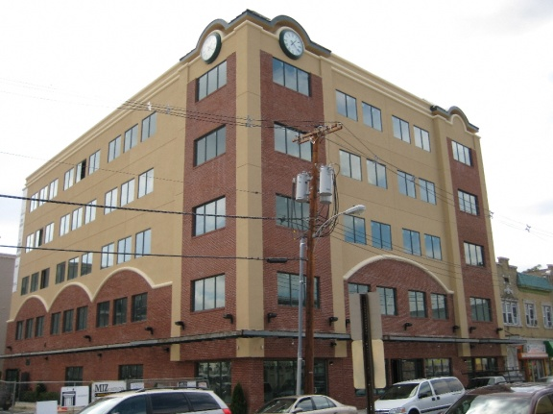

Lakewood Resource & Referral Center
Presented by:
Jay B. Braun, L.S.W., M.S.W., M.S. Ed.,
Director, LRRC
jbraun@lrrcenter.org
212 Second Street, Suite 204
Lakewood, New Jersey 08701
732-942-9292
Notes:
1

Slide 2

Lrrc welcomes…
ARRA STRENGTHENING COMMUNITIES GROUP

Slide 3
MISSION STATEMENT
Social Services Information And Referral (SSIRD) Division;
To provide the entire community with the most comprehensive, accurate and empathetic social services, information, referral, assistance and advocacy, for governmental entitlement and private sector programs throughout the entire spectrum of the human lifecycle experience. We strive to assess the total situation and needs of individuals and families and do not stop with the initial inquiry of issue or problem.
Notes:
3

Slide 4

About LRRC
THE LRRC PROVIDES A COMPREHENSIVE RANGE
OF FREE SOCIAL SERVICES FOR
Lakewood Township
Ocean County
New Jersey
Notes:
4
4

Slide 5
TODAY’S TOPIC
Maximizing Information
The Initial Interview
How this Effects Outcomes
Building Agency Capacity

Slide 6
Interview stages
Pre Interview Experience
Interview Experience
Post Interview Experience
Outcomes Measures

Slide 7
AREAS…
1
Pre Interview
2
Intake Forms
On Line Capabilities
Waiting Area
Physical Space
Privacy
Barriers
Reception Greeting
Timeliness
3

Slide 8
AREAS CON’T …
4
Referral Tracking
5
6
Data Base /Notes
Paper / Electronic Compatibility
Office Space
General Goals
Time Frame
Tools, Forms Scales
Establishing The Relationship
Empathy

Slide 9
AREAS CON’T …
7
Interview Type
8
9
Client Speech Patterns
Interview Success
Interview Styles
Interview Goals
Client Emotional Patterns
Client Body Language
Interview Missing Info
Outcome Measures

Slide 10
Pre interview, intake forms, on line
PRE INTERVIEW
Hours of Operation
INTAKE FORMS
Data & Demographics
Critical Socio-economic Status
ON LINE
Intake Forms Available
Electronic Submission
Appointment F/U Appt. Avail.
Corresponds to Electronic Rec’s
Encryption Security
Address, Directions & Parking

Slide 11
Reception Greeting , Waiting Area, phys. Space
RECEPTION
GREETING
Greeting Experience
WAITING AREA
Spaciousness, C/B, Pens
Water Cooler / Bathrooms
PHYSICAL SPACE
Sufficient Seating
Cleanliness
Timeliness
Child Friendly
Privacy
Marketing / Promotional / Ed. Mat

Slide 12
Timeliness, privacy barriers
Timeliness
Appointments Start Time
Privacy
General Privacy
HIPAA
Barriers
Receptionist Availability
Sufficient #
End Time
Tracking
FERPA
Appointment / Cancellation P&P

Slide 13
Referral, Db, paper Vs. electronic
Referral
tracking
Intake Form
Data Base
Funder
Audit Req.
Paper Vs.
Elect.
Corresponding Fields
Storage
Data Base
Marketing Tool
Internal Audits
Security

Slide 14
Office space, time frame, tools/forms
OFFICE SPACE
Layout
TIME FRAME
Length
Sufficiency
Tools, Forms, Scales
Professional
Validity /Reliability
Safety
Productivity Points
Comfortability
Security

Slide 15
General goals, relationship, empathy
GENERAL GOALS
Obtain Specific info
ESTABLISHING RELATIONSHIPS
Connecting
Allocation of Authority
Empathy
Listening Skills
Cultural Sensitivity
Formulate Intervention
Opened Ended ?’s
Understand the Client
Emotions

Slide 16
Client speech, emotions, body language
CLIENT SPEECH PATTERNS
Language Level
CLIENT EMOTIONAL PATTERNS
Strong Reactions
Interview Anxiety
Facial Expressions
Hand/Body Movement
Conflicting Emotions
Participation
Pattern & Spontaneity
Body Posture
Body language

Slide 17
Interview success, missing info, measures
INTERVIEW SUCCESS
MISSING INFO
Alternative Methods
F/U Vs, Goals
Outcome Measures
Client Surveys
Stats & Reports
LT Formulated
Concrete & Precision
Measurability
ST Goals Formulated
Info Obtained

Slide 18

Initial Interview summary
Appointment Availability
Physical Comfort
Emotional Comfort
Goals / Plan Effectiveness
Achievements
1st Point of Contact Exp.
Imparting information
Professional Exp.
Agency Outcomes

Slide 19

Initial Interview summary, con’t
An improvement in any or several of these areas
may lead to additional income and funding.
Physical Comfort
Emotional Comfort
Goals / Plan Effectiveness
Achievements
1st Point of Contact Exp.
Imparting information
Professional Exp.
Agency Outcomes

Slide 20

QUESTIONS & ANSWERS

Slide 21
Thank You!

